Slide 1

Bridging the Gap:
The Power of Patient Advocacy

Slide 2
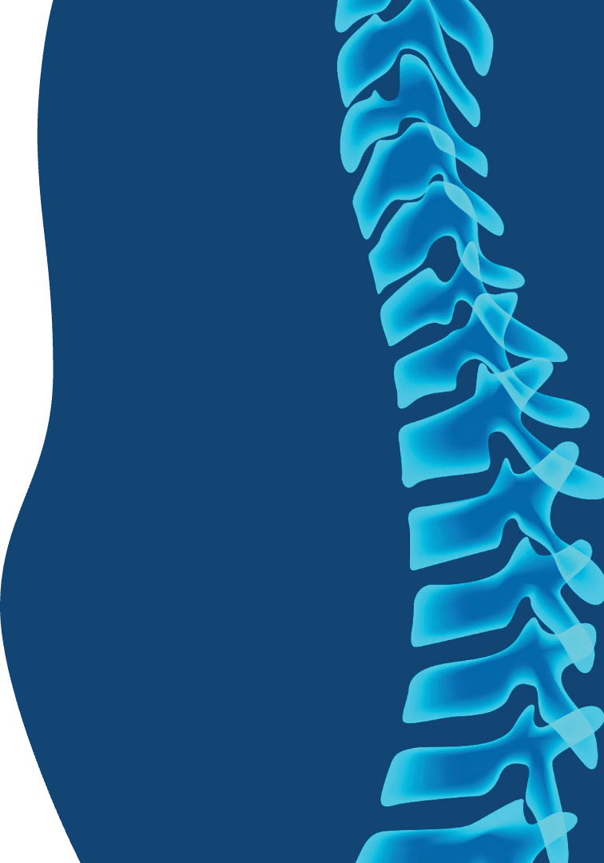
THERE HAS BEEN A REVOLUTION IN SPINAL HEALTHCARE!
Over The Past 25 Years, innovation in spinal healthcare have created revolutionary treatments giving patients options like never before in history.
More patients have access to excellent care
More patients have better outcomes
Surgeons and industry have developed masterful techniques and technologies
Neurosurgery and Orthopedic surgery coalesce
Partnerships among societies and registries like ASR and QOD
Evidence development: HSG, ISSG, and Societies LSRS, CSRS, NASS, SMISS, ISASS and more…

Slide 3


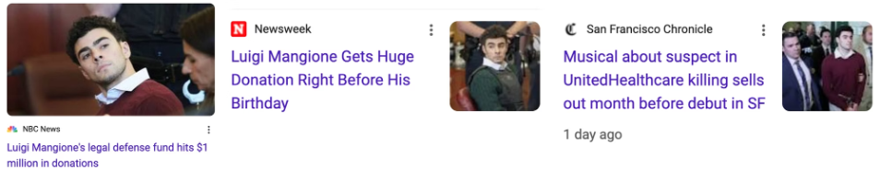
BUT the News is still BAD!
Headline
Source
Date Reported
Spinal Cord Stimulator Harms Exposed
abc.net.au
2024-04-09
Experts Advise Against Common Spine Injections
bmjgroup.com
2024-11-05
Unnecessary Spine Surgeries Highlighted
forbes.com
2024-12-04
Rise of Unnecessary Spine Surgeries Concerns Physicians
ORmanager
2024-03-08
Children's Spinal Surgery Waitlist Crisis
thesun.ie
2024-12-15
New Study Predicts Post-Op Spine Complications
ryortho.com
2024-08-10
MORE BAD NEWS… Did chronic back pain and a failed back surgery drive him to do it?

Slide 4





Social Media & Advertising Negative Headlines
Fear-Based Headlines
Overpromising Solutions
Commercial Scare Tactics
Exaggerate danger, cause unnecessary anxiety, lack medical nuance.
Oversimplifies complex conditions, gives false hope, misrepresents treatment outcomes
Exploits fear to sell products/services, often lacking scientific support.
"Your Back Pain Could Be a Sign of Something Deadly"
"This One Stretch Will Fix Your Back Forever"
"Your Desk Job Is Killing Your Spine—Buy This Chair!"
Misleading Terminology
Anecdotal Claims
Uses outdated or incorrect terms, can lead to misdiagnosis or overtreatment.
Relies on personal stories instead of clinical evidence, may promote pseudoscience.
"Slipped Disc? Only Surgery Can Help"
"My Chiropractor Cured My Sciatica in One Visit"

Slide 5

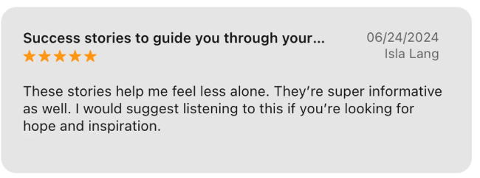
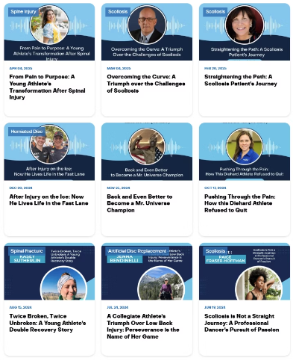
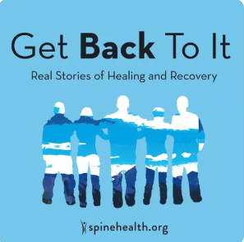
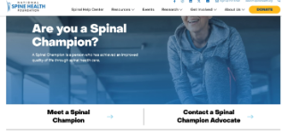
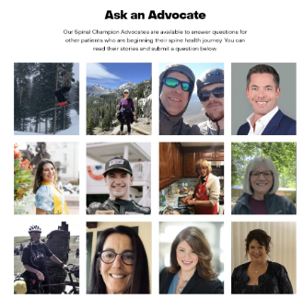

It’s time to tell the truth about the GOOD NEWS…
Testimonials provide trusted, authentic, credible, sources of information
"Looking back on my surgery, I'm so happy I did it because now I can do everything I wanted to do. I don't have to worry about the way I look or the way I feel or any pain. I wouldn't have it any other way.” - Michelle
“Many people incorrectly believe that back surgery will leave you debilitated for a lifetime; when in fact, for me and many others, it is often the key to getting back to the life you love.” - Ray

Slide 6

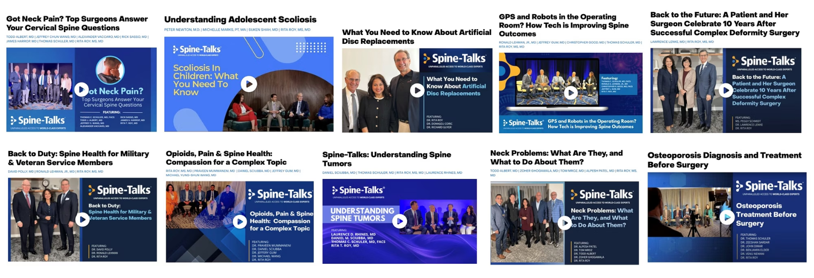
Trusted Resources Build Patient Confidence
Unparalleled access to world-class experts

Slide 7

Trusted Resources are Created With and By the Leading Experts… this Creates Authoritative Digital Content

Slide 8
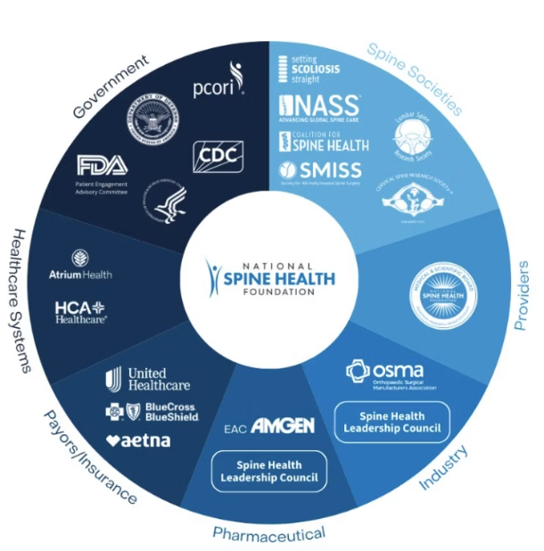
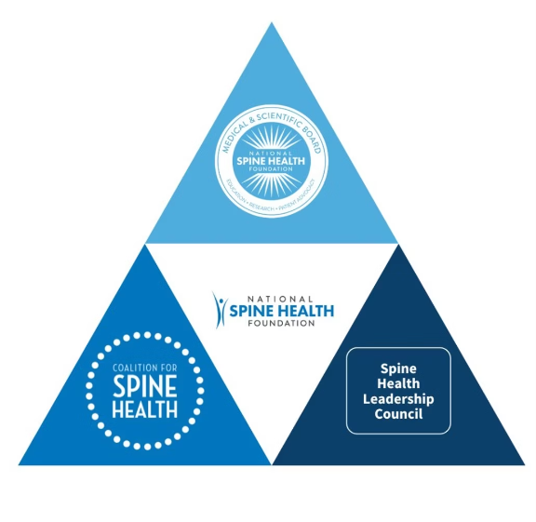
Expert Collaboration within the Spine Industry
The NSHF Spinal Ecosystem
NHSF represents the patient voice. This unique perspective is at the center of the ecosystem, where all stakeholders are represented on the spine health continuum.​
Builds Authority and Trust
Amplify, Support and Augment Messaging
​

Slide 9
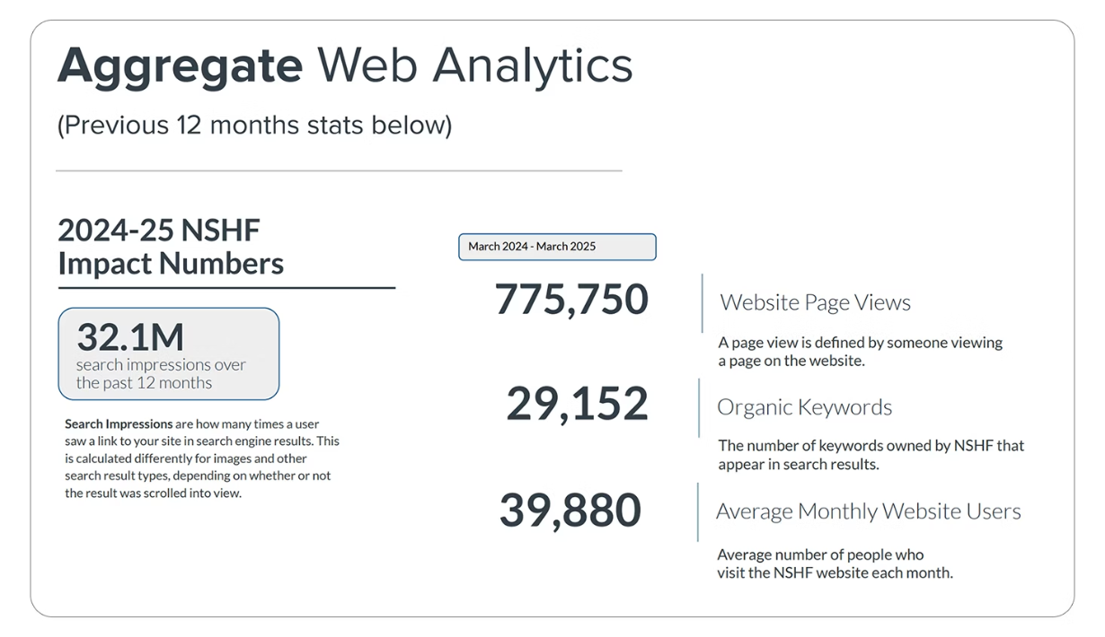
Authoritative Digital Content Drives SEO
Our website, spinehealth.org was launched in September 2019 (5 years ago)

Slide 10
Context of Digital Reach For Comparison
Benchmark Estimates:
Factors That Influence
Page Views:
Organization
Est. Monthly
Page Views
For national, single-disease healthcare non-profits:
1. Disease Prevalence
American Heart Association (AHA)
~845,000
Monthly Page Views
More common diseases (e.g., diabetes, breast cancer) attract more attention and web traffic.
50,000 to 500,000 is typical.
Top-tier organizations may exceed 1 million monthly views, especially during awareness campaigns or fundraising seasons.
American Academy of Orthopaedic Surgeons (AAOS)
~820,000
2. Content Depth & SEO
Educational resources, patient stories, and advocacy news improve visibility.
American Diabetes Association
1M+
Cystic Fibrosis Foundation
100K–300K
3. Fundraising Campaigns
Annual Page Views
Traffic spikes during events like awareness months or donation drives.
Lupus Foundation of America
50K–150K
600,000 to 6 million annually is a common range.
National Multiple Sclerosis Society
200K–400K
4. Partnerships & Media
NSHF Page Views
Collaborations with influencers, media outlets, or pharma can drive large temporary surges.
National Spine Health Foundation
~65k
NSHF reached 775,000 in the last year.

Slide 11
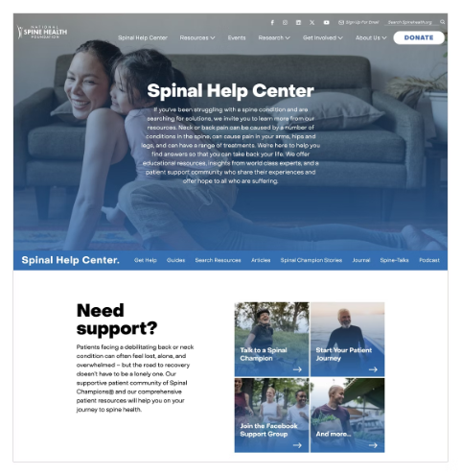






Why Should We Bother?
Informed patients have better outcomes, but where do they get their information?
Resources for Spine Patients: spinehealth.org
Informed Patients Have Better Outcomes
Outcome Area
Impact of Informed Patients
Key Study / Source
Treatment Adherence
Increased adherence to medications and care plans
Horne et al., BMJ, 2005
Patients with better understanding had higher adherence
Knowledge & Decision Quality
Lower informed decisions, reduced decisional conflict
Stacey et al., Cochrane Review, 2014
Decision aids improve knowledge & involvement
Anxiety & Emotional
Well-being
Lower anxiety, fear, and stress before procedures or diagnosis
Johnston & Vögele, Psychol. Bulletin, 193
Pre-op education reduces anxiety
Chronic Disease Management
Higher satisfaction and improved provider-patient communication
Levinson et al., JAMA, 2005
Better communication improves trust and satisfaction
Overtreatment/Costs
Better self-management and improved clinical metrics (e.g., HbA1c, BP)
Norris et al., JAMA, 2002
Diabetes education improves glycemic control
Litigation Risk
Decreased malpractice claims & legal conflict when patients feel heard and informed
Wennberg et al., Health Affairs, 2013
Shared decision-making reduces costs

Slide 12
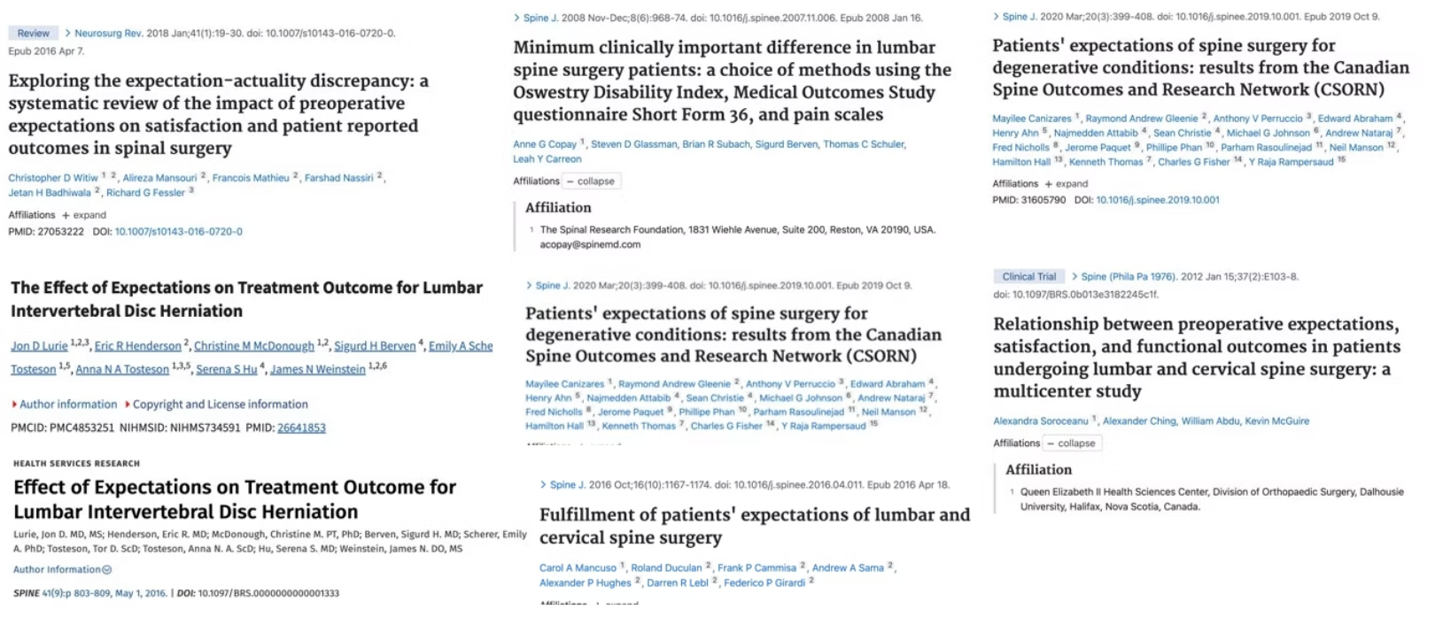
Why Should We Bother?
Appropriate Expectations Drive Patients Outcomes and Satisfaction

Slide 13

Expectation Studies in Summary​
The Conclusions From Expectation Studies: Expectation management is a crucial, modifiable factor in spine care. By aligning expectations through education and shared decision-making, providers can enhance satisfaction and potentially improve clinical outcomes.​
1
Importance of Patient Expectations
Predictive of satisfaction and outcomes
Influence on pain, function, recovery
2
Influence on Surgical Outcomes
Unrealistic expectations linked to dissatisfaction
Positive expectations associated with better results
3
Expectations vs. Reality Gap
Mismatch due to inadequate counseling
Over-optimistic interpretations of benefit
4
Role in Non-Surgical Spine Care
Belief in efficacy linked to perceived benefit
Enhances adherence and engagement

Slide 14
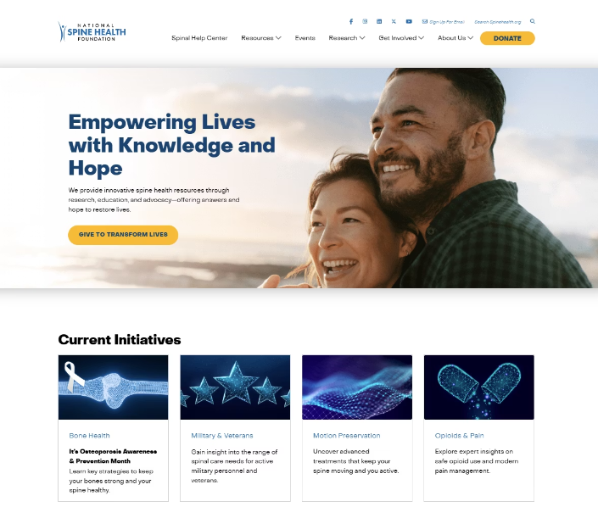
Addressing Spine + Public Health Crises
Strategic Initiatives: Challenges facing the public that need to be addressed, NSHF fills the gap.
Osteoporosis Epidemic
Opioid Crisis
Addressing bone density issues through education and prevention strategies.
Promoting alternative pain management approaches for spine patients.
Motion Preservation Access
Military & Veterans Care
Advocating for advanced treatment options that maintain spinal mobility.
Supporting specialized spine care for those who served our country.

Slide 15




The Power of Patient Advocacy
Trusted Source
Donate
Contribute
Visit NSHF
Supporting providers by augmenting and supplementing their practice/institution’s information. When it comes from an unbiased non-profit, it is trusted.
Doing this work is costly, relies on grants, industry sponsors, and individual donors are critical.
Public charities are required by law to provide opportunities for the public to contribute and are required to have many members of the public supporting it.
If you want to support the mission, you can send your patients to spinehealth.org.
If you wish to contribute and be part of this organization, consider joining the Spinal Alliance. Information will be available at the Happy Hour.

Slide 16

The National Spine Health Foundation
is the Bridge to Improved Patient Knowledge
and Therefore Improved Patient Success.

Slide 17
